Slide 1
High Power Density Inverter for Solar Power Applications
Electrical and Renewable Energy Dept.
May. 2015

Slide 2
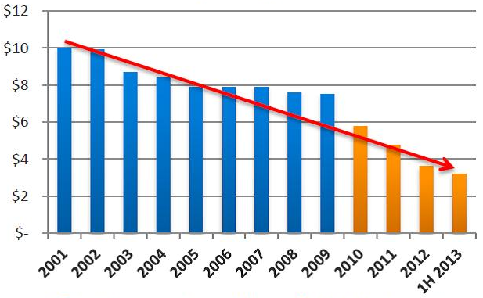
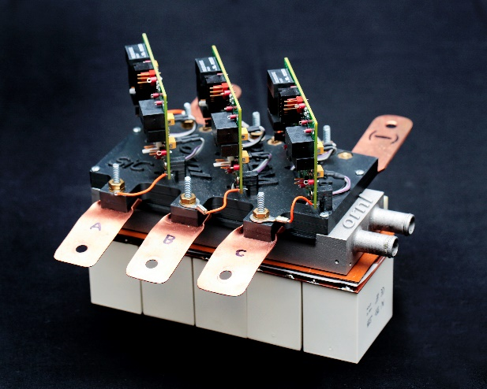
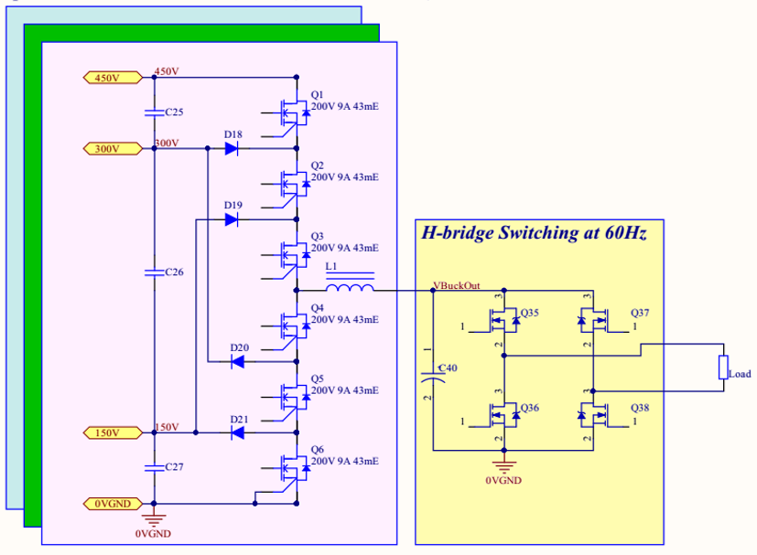
Agenda
$ / W
Motivation
Research Objective
Background
Approach
Plan
Budget
Typical
techniques
Approach
Photo by:
SEIA/GTM Solar Energy Facts: Q2 2013
http://www.ornl.gov

Slide 3
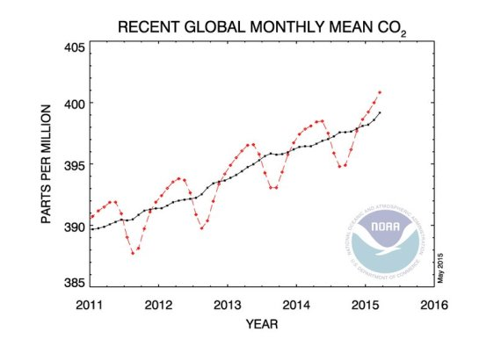

Slide 4
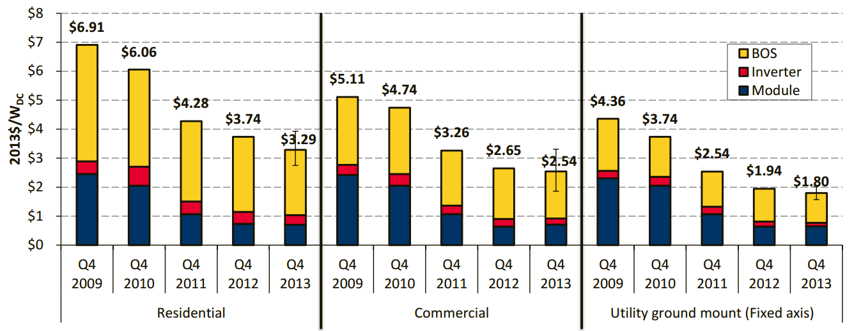
Motivation
Balance of System (BOS) cost dominates the price per Watt of PV systems in recent years
Chart from: “Photovoltaic System Pricing Trends”, NREL, Sep. 2014
Notes:
My main motivation is to reduce solar pv system cost.
Increasing inverter power density may not lead to reduction of inverter manufacturing cost immediately, although in the future it will.
However I discovered that increasing inverter power density lead to the reduction of other more important cost that is the Bos cost.
This chart from NREL is the cost per watt of PV systems during the past 5 years for Residential, Commercial and Utility Sector of PV market. PV system cost is divided in to 3 primary parts: PV module, Inverter, and Balance of System cost, which is the total of all other costs other than PV module and inverter.
The chart shows that the balance of system cost contributes the biggest percentage of dollar per watt in PV system in 2013.
The majority of cost reduction opportunity is in the BOS cost.

Slide 5
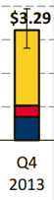





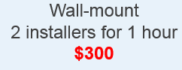
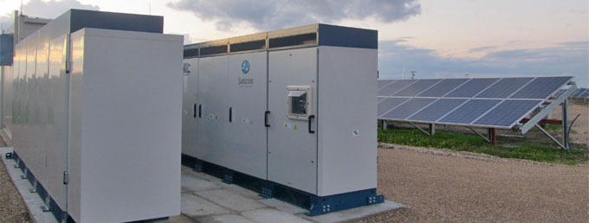
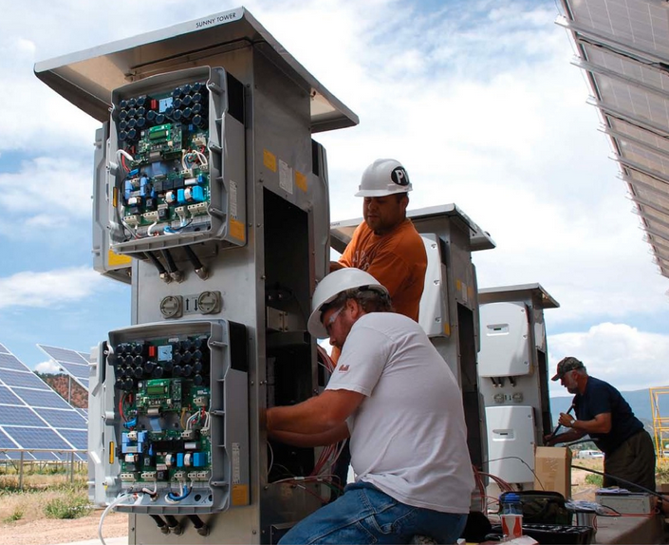
Motivation
Increasing inverter power density leads to significant reduction of BOS cost
30kW inverter
Small inverter
Notes:
Interestingly, BOS cost is correlated to the inverter power density.
Inverter weight not only affect material and manufacturing cost for supplier but it also affects the costs of shipping, installation and maintenance, significantly
Large inverter requires concrete, crane for installation, while small inverter can be easily installed by man into existing building infrastructure.
Small inverter simplify the installation and maintenance because it’s more easily replaced when fail.
Increasing inverter power density can lead to significant cost reduction for PV system. This is my main motivation.

Slide 6


Research Objective
Increase power density of Solar inverter
Design & prototype a high power density inverter following the spec of The Little Box Challenge
Handle up to 2 kVA loads, with power factor 0.7 - 1, leading or lagging.
Operate in an off-grid (micro-grid) mode with load changes similar to a residential household.
Output 240V 60Hz
Have a voltage total harmonic distortion + noise (THD + N) of < 5%
Long operating life with minimal service requirements.
Notes:
I will try to increase power density of solar inverter.
I will design & prototype a high power density inverter following the Little box challenge contest by Google and IEEE.

Slide 7
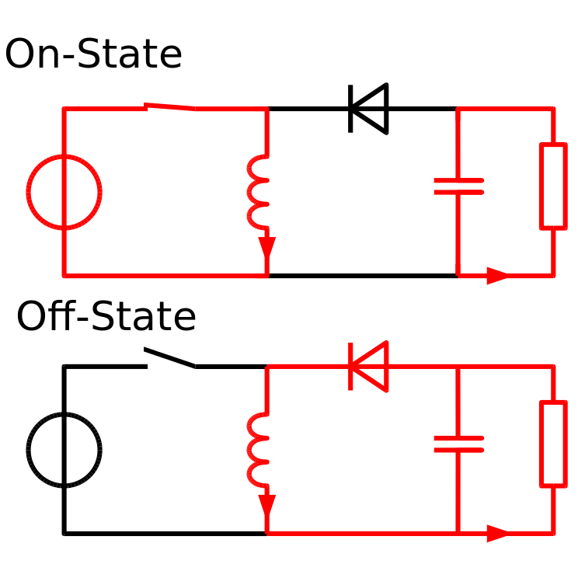

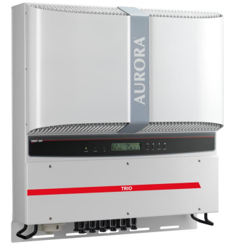
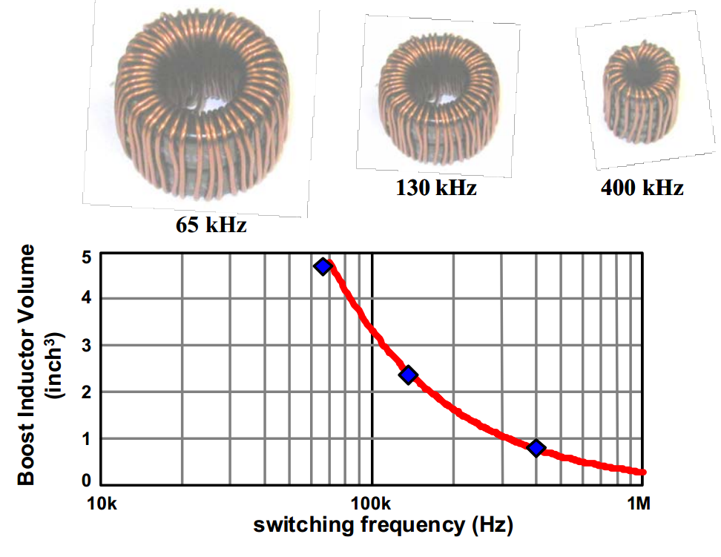
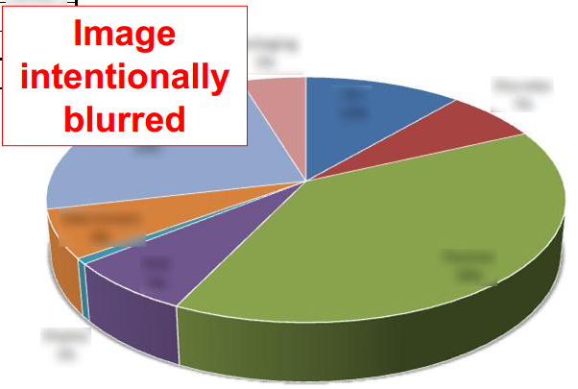
Background
The classic technique rises switching frequency to reduce passive energy storage elements (capacitor & inductor)
Passive
From: Chuanyun W., Investigation on Interleaved Boost Converters”, PhD thesis, Virginia Tech, 2009
ABB – Aurora Trio 10KW
Notes:
On studying commercial solar inverters, one fact that becomes obvious is that the bulk of the system, that is its volume and weight, comprises primarily cooling and passive energy storage elements. Semiconductor devices, on the other hand, occupy only a small fraction of the total footprint.
The well-known technique focus on reducing passive energy storage elements by raising the switching frequency. When switching frequency increase, the amount of energy that the circuit has to handled every cycle decrease. Therefore, inductance and capacitance requirements reduced.
For example is a simple buck-boost converter on the top right. The buck-boost converter has 2 states: the on state and the off state. In the on state, inductor takes power from DC source, and in the off state it discharges that power into the load. Apparently, the longer the switching time, the bigger the energy that the inductor has to transfer in each cycle, which results in larger inductance.
The chart on the lower right corner shows inductor volume decrease quickly with switching frequency.
This is a general technique that can applies to all types of converter from DC/DC to DC/AC.

Slide 8
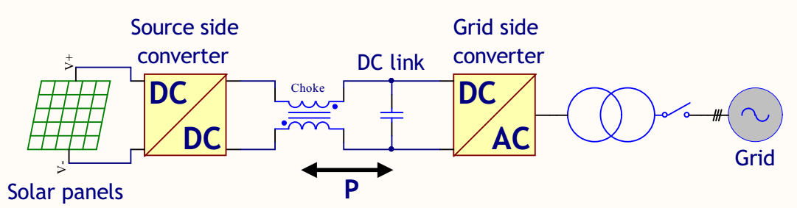
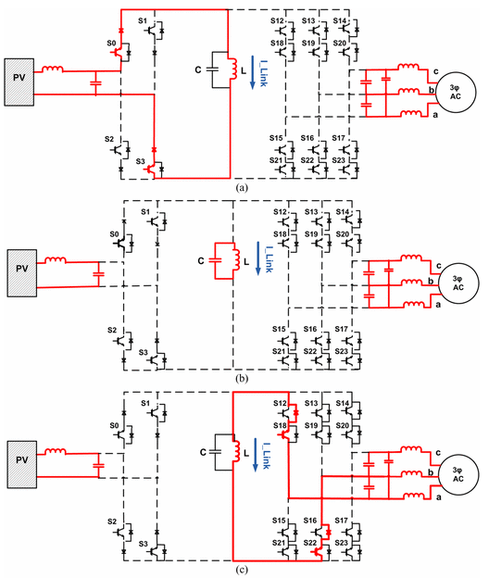
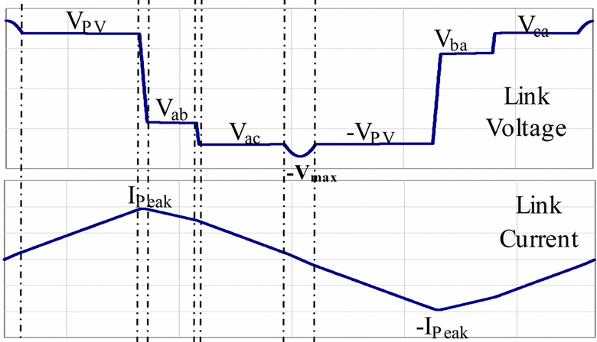
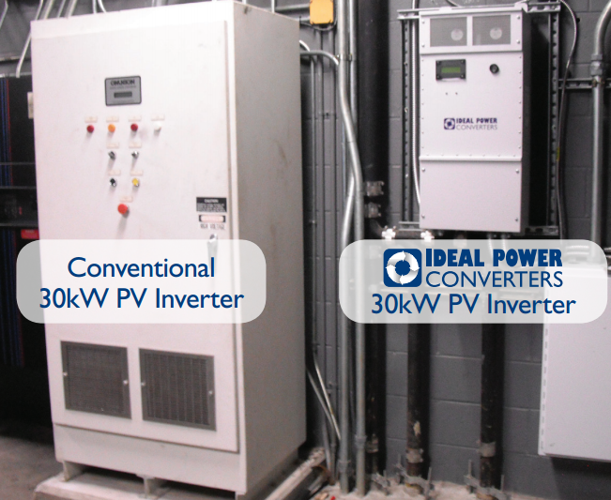
New technique eliminates DC link capacitor and choke inductor
Traditional converter with DC link
New approach with AC link
Toliyat H.A., et al "Soft switched ac-link direct-connect photovoltaic inverter," Sustainable Energy Technologies, IEEE International Conference on, Nov. 2008.
Notes:
This is a new technique developed by Dr. Toliyat at Texas A&M University, College Station, Tx in 2008. Instead of trying to increase the operating frequency, Dr. Toliyat trying to eliminate the DC link completely therefore reduce inverter size substantially. Because the bigger part in traditional inverter is the DC link capacitor and choke inductor.
The operation is similar to buck-boost converter. On the first state, the inductor takes power from DC source. Then in the final state, it discharges that power into load.
Output voltage is calculated based on how long it take power from DC source and how long it discharge power to load.
The biggest disadvantage is that this topology requires bidirectional switching components, which is expensive, and non-standard.
The invention has been commercialized by Ideal Power Converters corporation. According to the company, their inverters achieve 10x improvement in power density compares with traditional transformer based inverter.

Slide 9
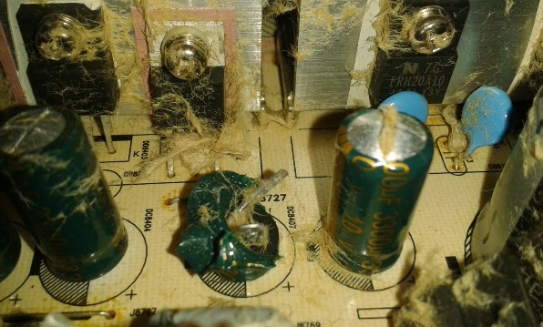
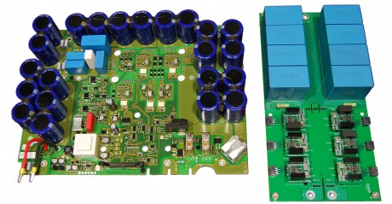
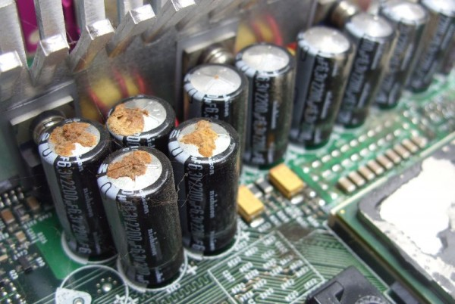
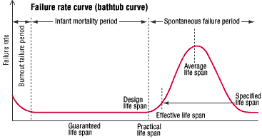
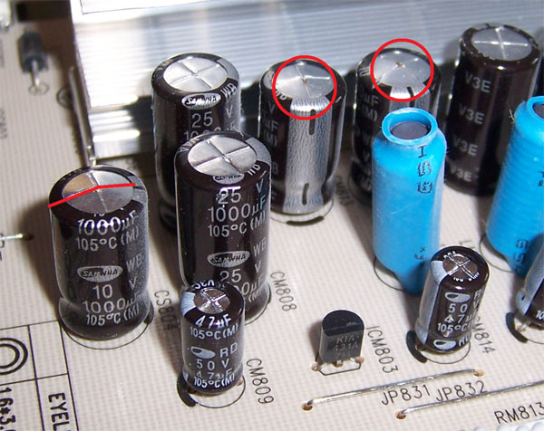
Background
Reducing the size of inverter unexpectedly improve reliability
Sandia Labs, Photovoltaic Inverter Reliability, Ward Bower, 2000.
Notes:
An unexpected benefit when increasing inverter power density is improving reliability.
According to Sandia Labs PV Inverter Reliability report, electrolytic capacitors, which used inside most inverters, are the primary cause of system failure.
High power density inverter has lower requirement for capacitor. Therefore film capacitors can be used replacing electrolytic capacitor. Film capacitor has much longer lifetime.

Slide 10
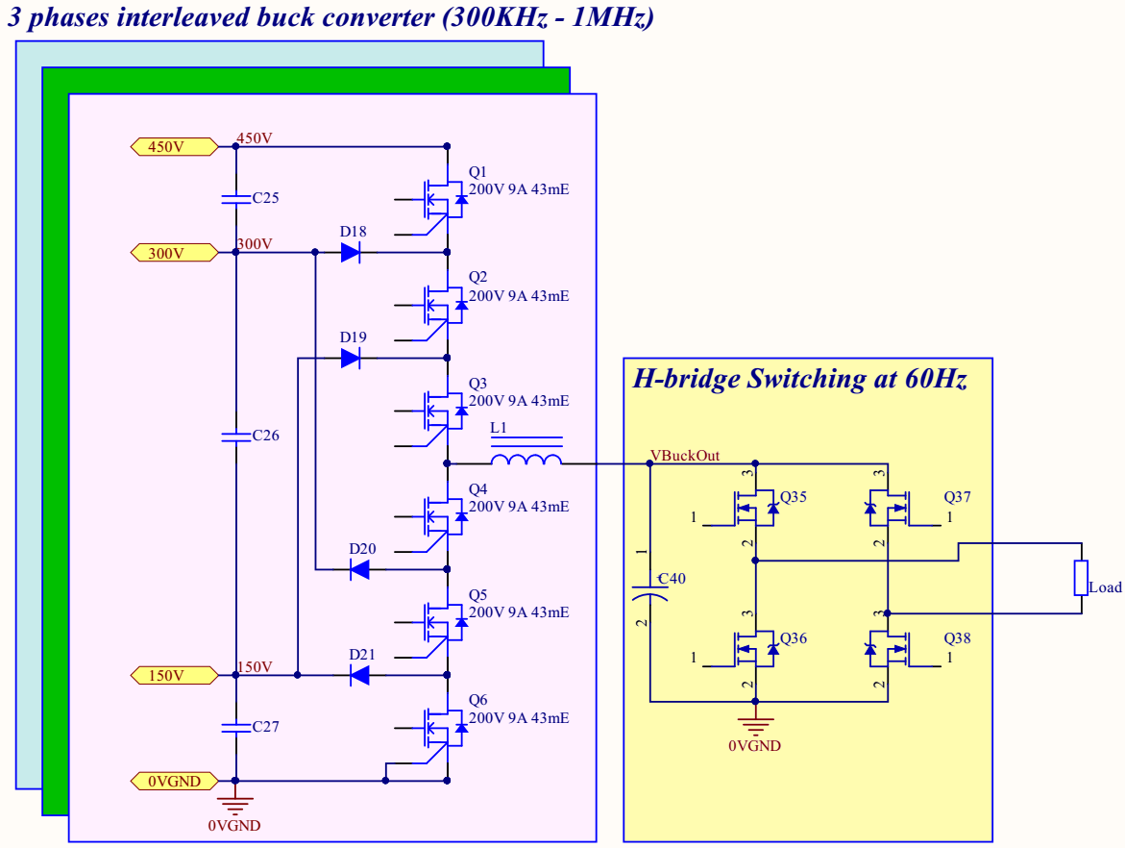
Proposed Research: Circuit Topology
My initial approach follows the traditional path, increase switching frequency:
EPC’s GaN mosfet
Multi-levels inverter
3 channel interleaved operations.
Notes:
This is my initial design. There are 3 factors in the design that enable very high frequency operation of the inverter: Multi-levels inverter, 3 channels interleaved, and EPC GaN mosfet which is a mosfet from high band gap semiconductor.

Slide 11
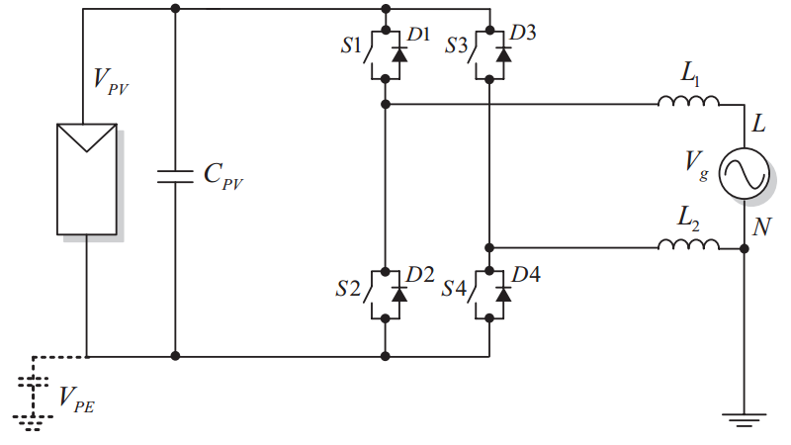
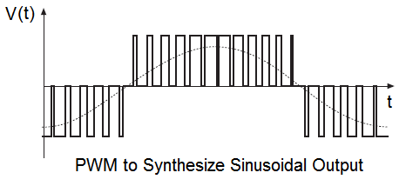
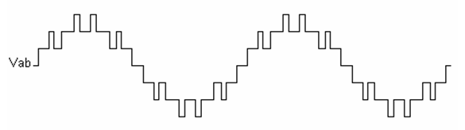
Multi-levels inverter allow higher switching frequency, uses low voltage mosfet, reduces dv/dt
Full bridge inveter (3 levels)
Modified NPC inverter (7 levels)
Notes:
Although multi-level inverter is complicated in design and control, it has many benefits.
The first benefit is it allows mosfet switch at lower voltage and therefore Mosfet can switch at higher frequency.
Intuitively, it is faster to switch between 0V and 150V than to switch between 0 and 450V
Intel has been constantly reducing their CPU core voltage in order to achieve higher speed.
The second benefit of multi-levels inverter is it allows using lower voltage mosfet, which has lower on resistance, cheaper, lower parasitic, etc.
And the third benefit is it reduce dv/dt which reduce EMI.

Slide 12
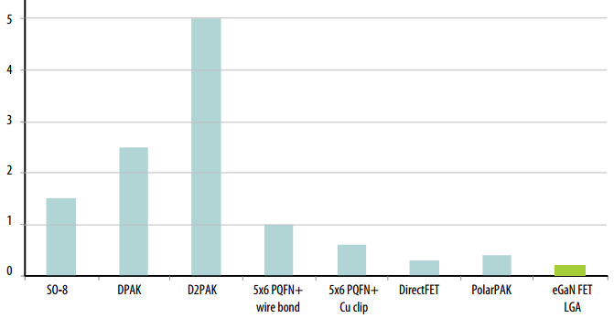
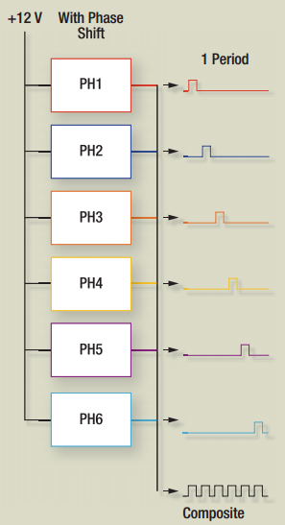
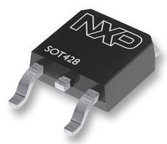
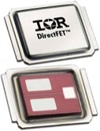
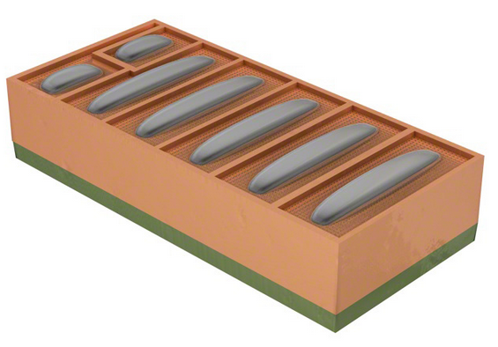
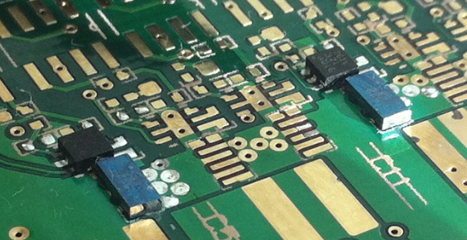
Proposed Research: Mosfet selection
Lowest parasitic package is among important advantages of EPC’s GaN Mosfet
3 channels interleaved operation triples the effective output frequency, easy thermal management
nH
Notes:
The second and third features of my design that enable higher switching frequency are 3 channels interleaved operation and GaN mosfet.
The 3 channels interleaved operation triples the effective output frequency and make it easy for thermal management.
The third feature is the use of GaN mosfet which is famous for high freq. switching capability.
It is well known that GaN mosfet has lower switching loss, lower parasitic and capable of switching at higher frequency that the traditional silicon mostfet
Among all of GaN mosfet that currently on the market, EPC mosfet has lowest parasitic package.
Low parasitic inductance is one on the most important figure in designing high frequency

Slide 13
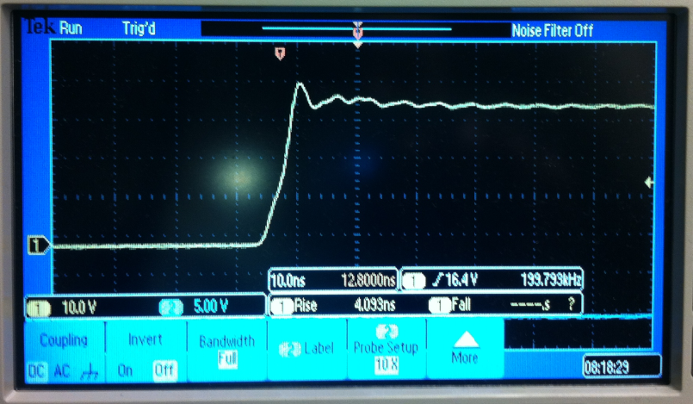
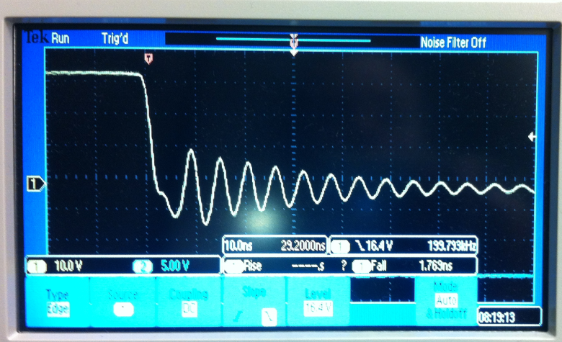
Initial Results
Initial switching tests of alpha PCB show high voltage overshoot.
Switching test at 20V, 100kHz, no load
Rising 4ns, overshoot ~15% (good)
Falling 1.8ns, overshoot ~33% (bad)
Inverter designed to operate at 450VDC input. Multilevels converter => 150V per mosfet => 33% overshoot will kill 200V Mosfet.
Possible solutions: increase falling time, use clamping circuit, use higher levels converter
Improvement: try to eliminate DC link
Notes:
I have built a circuit for testing my idea.
Switching tests show that GaN mosfet can switch really fast compares to normal mosfet that I worked with in the past. This confirm what people said about HBG semiconductor.
An issue with the current solution is that it has quite high voltage overshoot, which might kill the mosfet.
Possible solution that I’m thinking of is increase the falling time to reduce the overshoot but if we increase the switching time, switching loss increase
Other solution may be using of clamping circuit which also increase switching loss.
Or use higher levels inverter which make the circuit much more complicated to a point that it is unpractical
A very potential improvement to my current solution is to eliminate the DC link like Dr. Toliyat solution. Dr. Toliyat solution is based on buck-boost converter. My solution is based on buck converter.
If I can come up with a way to eliminate the DC link, it will result in a very novel idea combining the benefit of new technology of GaN mosfet, high switching circuit and DC link elimination.

Slide 14
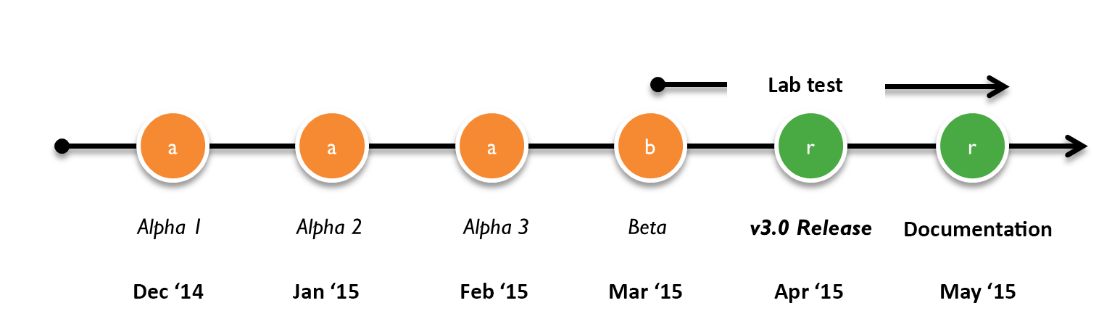
Timeline
Initial testing (Alpha 1, Alpha 2, Alpha 3) partially working inverter.
Fully working prototype (Beta) : due March 15, 2015
Final working design (Release) : due April 15, 2015
Expected thesis submission : May 01, 2015
Expected thesis defense : June 23, 2015

Slide 15
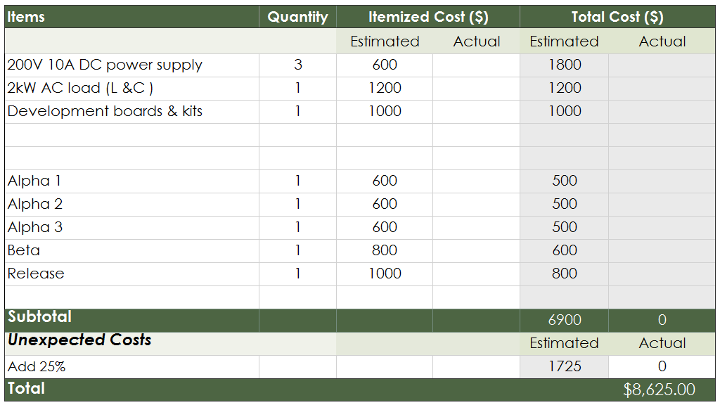
Estimated Budget

Slide 16
Conclusion
Improving Solar inverter power density
Reduces installation & maintenance cost
Increases system reliability
Has much larger benefit beside solar power applications
Known techniques tries to reduce passive components by:
Increase switching frequency
Eliminate DC link
Current proposed solution
7 levels inverter, 3 channels interleaved, EPC’s GaN mosfet
Has high voltage overshoot
Improvement: eliminate DC link

Slide 17


Slide 18
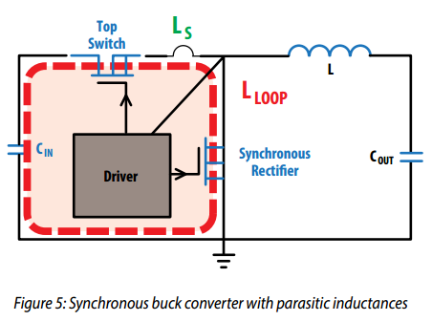
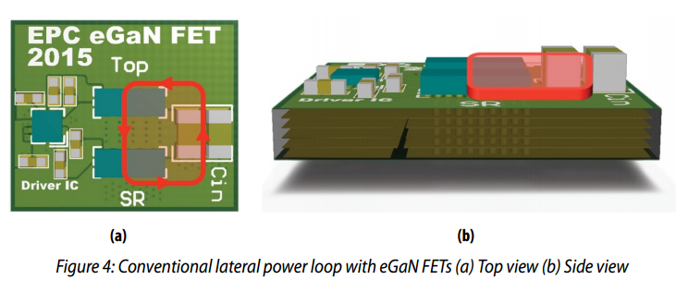
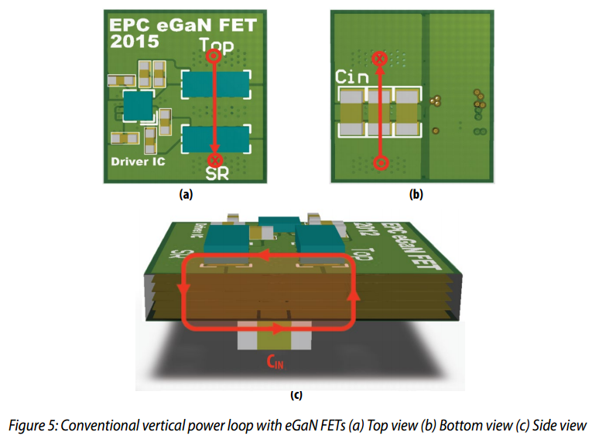
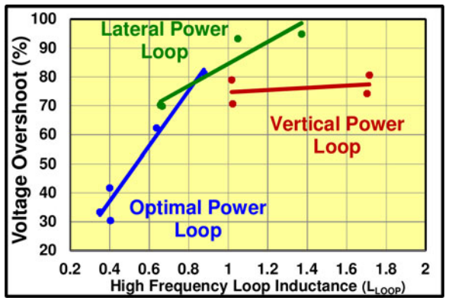
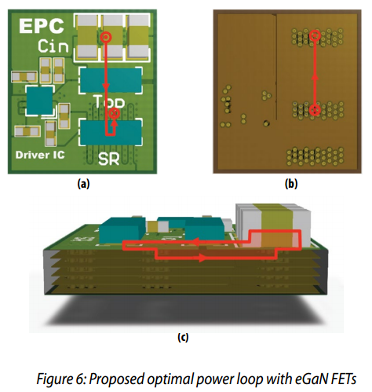

Slide 19
